Slide 1
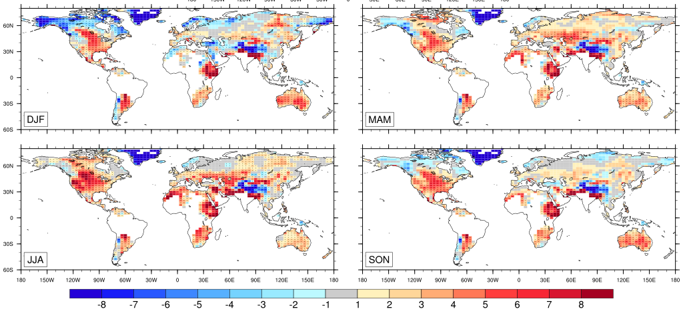
JULES
Tmin [JJA]
Tmax [JJA]
P [JJA]
CABLE
TMIN
Note how the CABLE biases are similar to JULES spatially and magnitude but CABLE biases are SMALLER over quite a range of regions

Slide 2
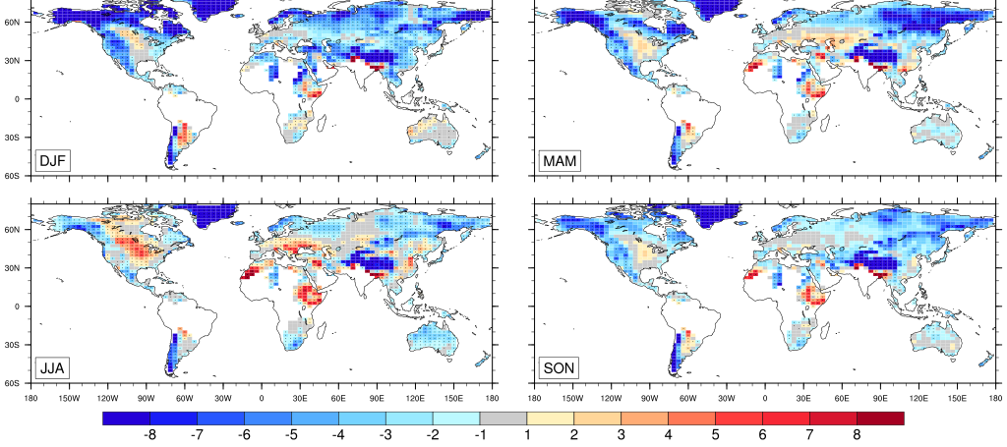
JULES
Tmin [JJA]
Tmax [JJA]
P [JJA]
CABLE
TMAX
Note how the CABLE biases are similar to JULES spatially and magnitude but CABLE biases are SMALLER over quite a range of regions

Slide 3
Rest of these are key dianostic fields that explain on-going biases?

Slide 4
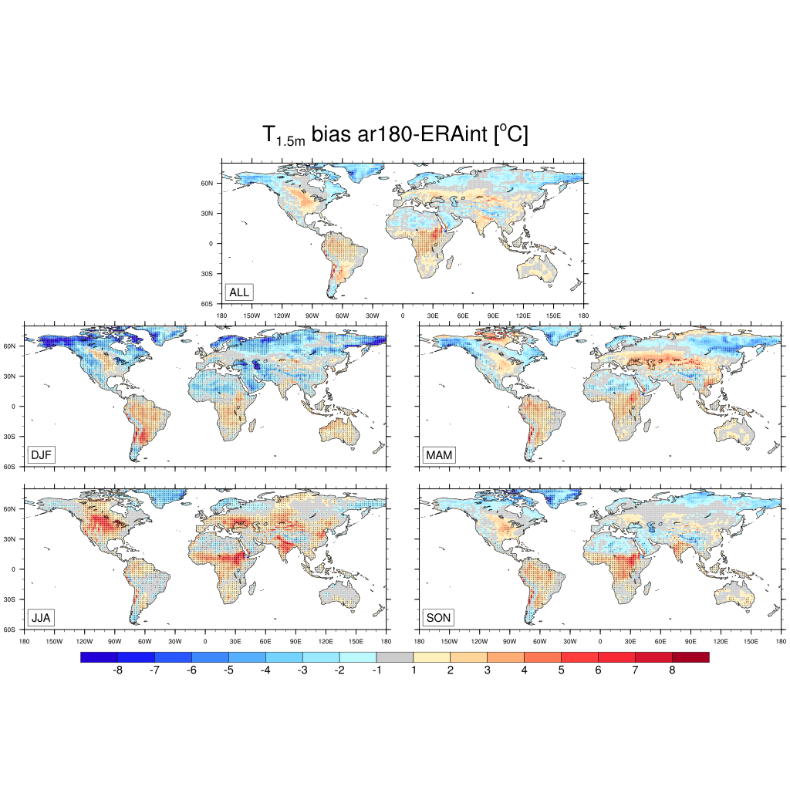
Screen temperature
Not bad – probably some errors larger than we might like … but really not bad

Slide 5
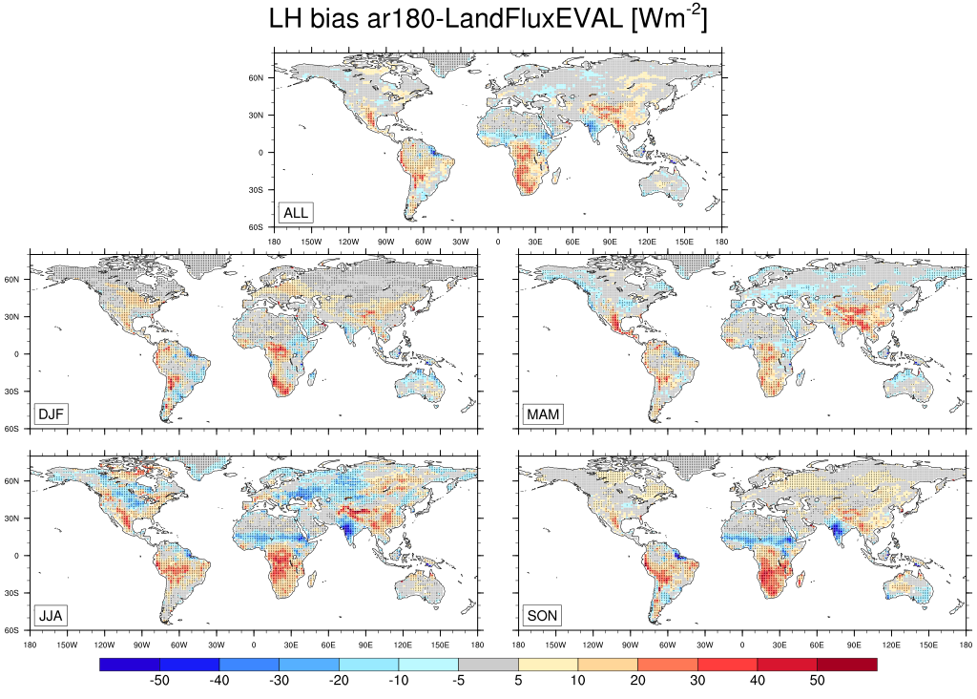
Evaporation
Not bad – probably some errors larger than we might like … but really not bad. Issues
Over southern Africa, India.

Slide 6
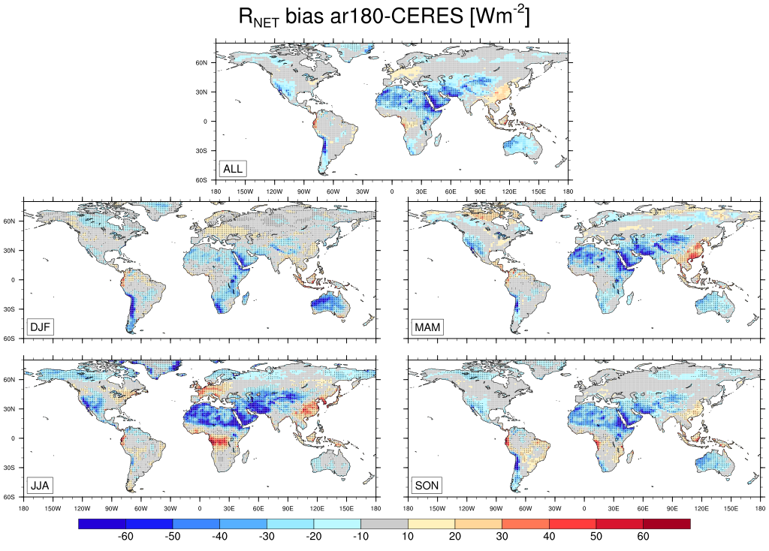
Some large biases relative to CERES but almost all coincident with deserts

Slide 7
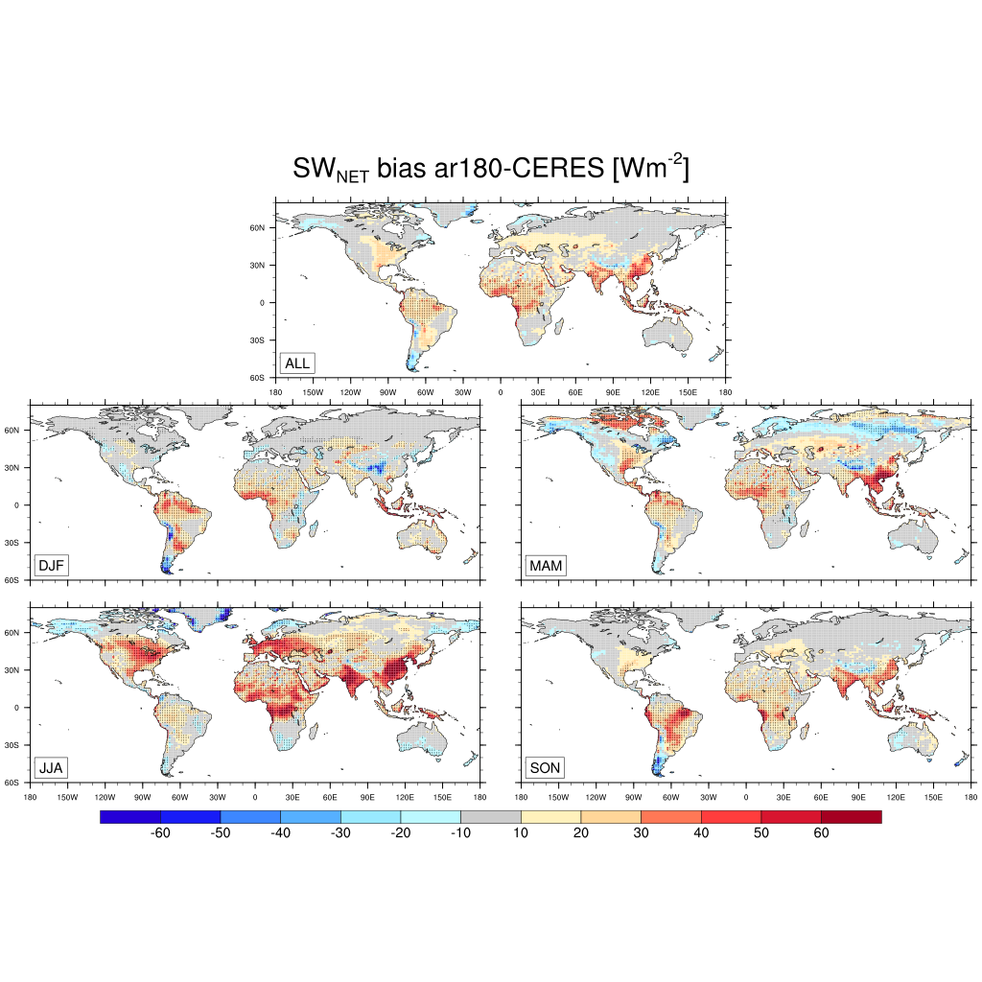
Net solar
Some large biases in net solar

Slide 8
Solar error
Very strong link with errors in solar with errors in temperature – strongly pointing to clouds.
I bet if we could fix clouds, we would get temperature very well.
1.5 m T error

